Slide 1
KLAXHON
The web leading the trend, style of dress.

Slide 2


Group members
Thanapat Rattanamontree
ธนภัทร รตนมนตรี
63109010297
Sirahiran Dumrongthawatksem
ศิรหิรัณย์ ดำรงธวัชเกษม
63109010241

Slide 3

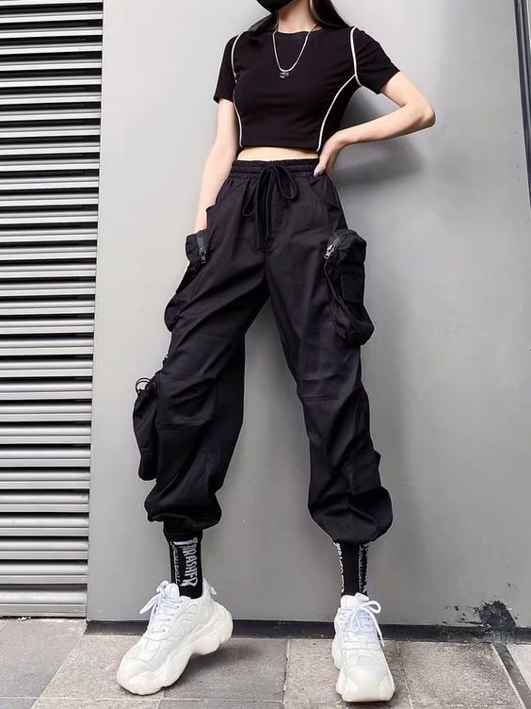
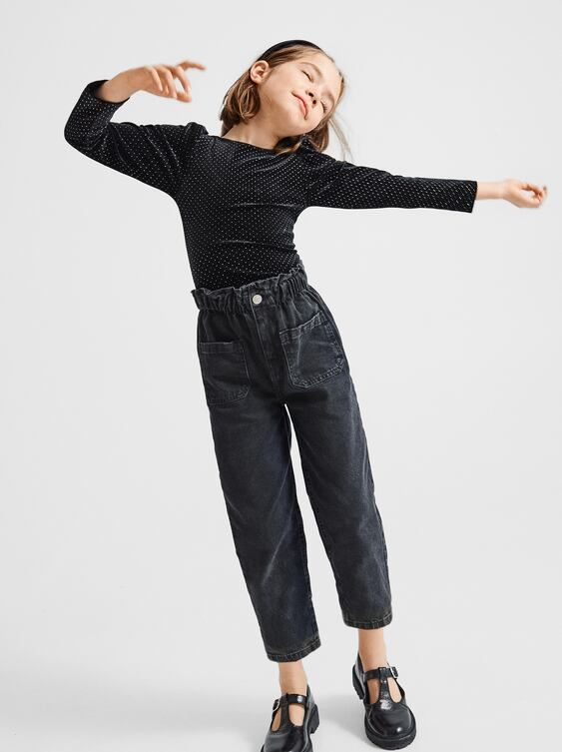
What is KLAXHON?
KLAXHON is a new brand of cool fashion, which mean thorough and the pronunciation seem like a Thai word. This brand having many of cool style for men, women and kids. So everyone who interested in cool style can visit website for make some idea for your dressing. In addition, KLAXHON also developing to make this brand being world-wide known.

Slide 4
CONTENT ON EACH PAGES
01
HOME
02
WOMEN
03
MEN
04
KIDS
The main page brand of KLAXHON.
The main page included fashion for women.
The main page included
fashion for men.
The main page included
fashion for kids.

Slide 5



Our Tools
HTML
Visual Studio Code
CSS

Slide 6
01
HOME
The main page brand of KLAXHON.

Slide 7

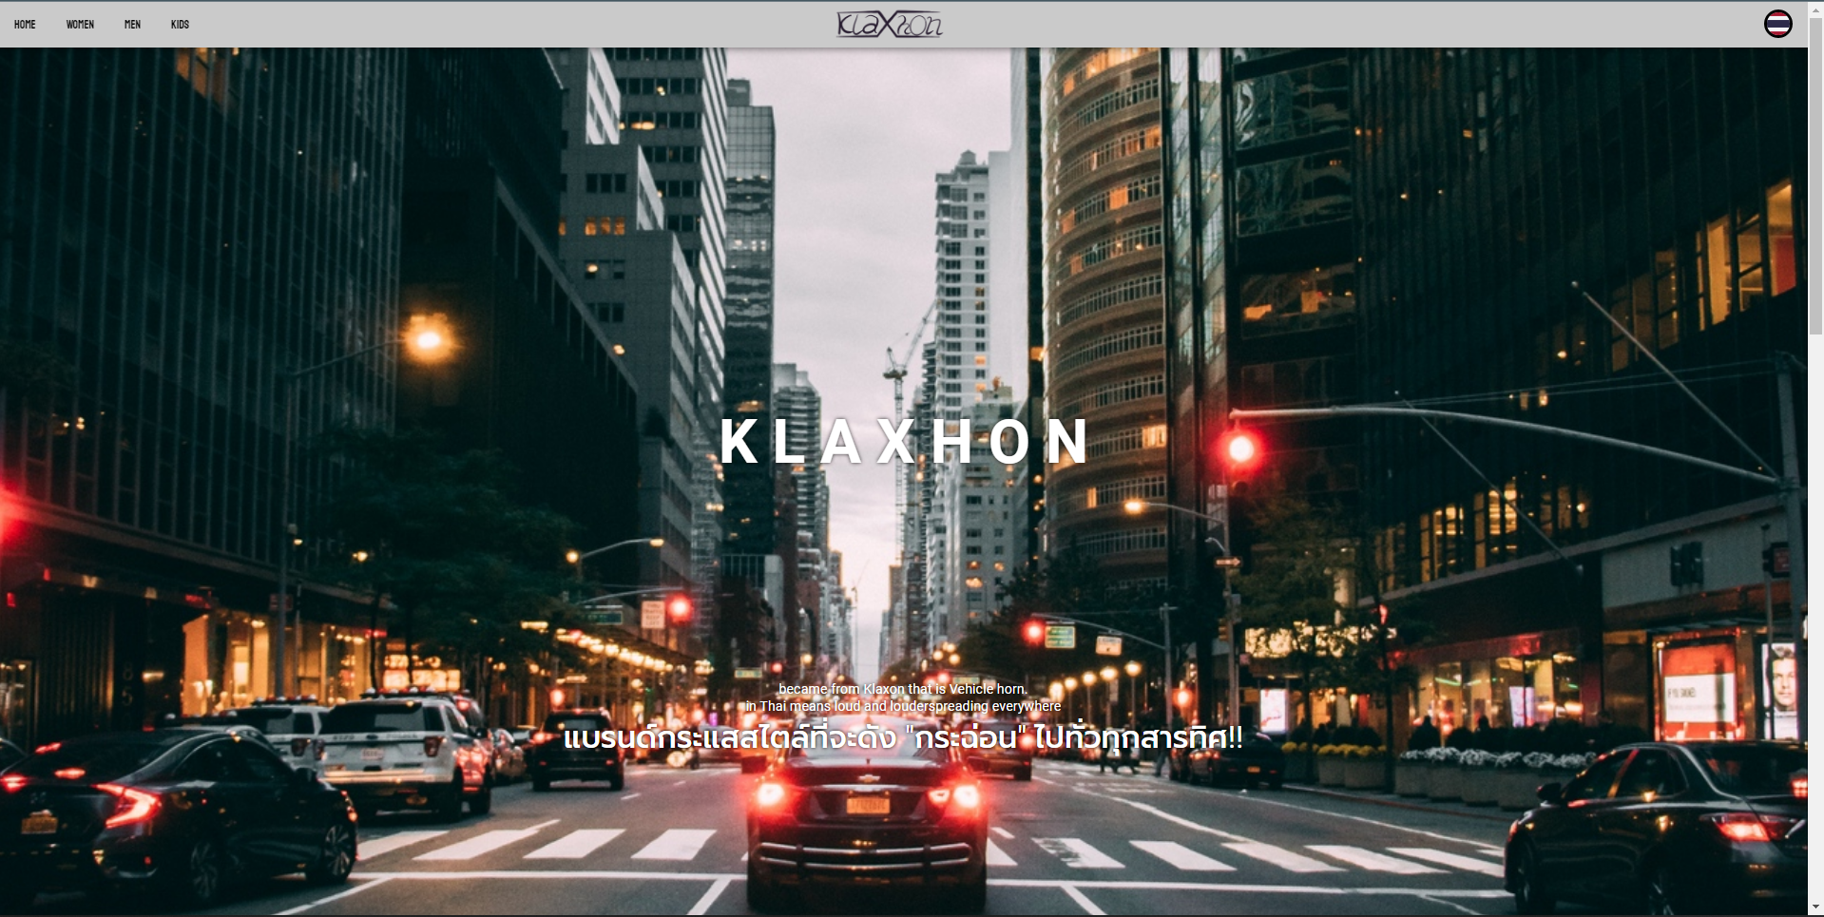
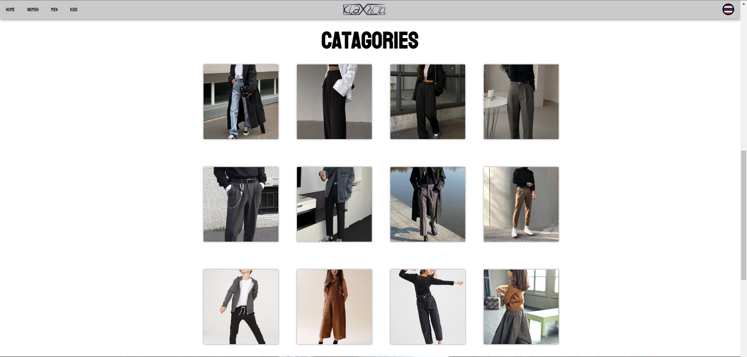
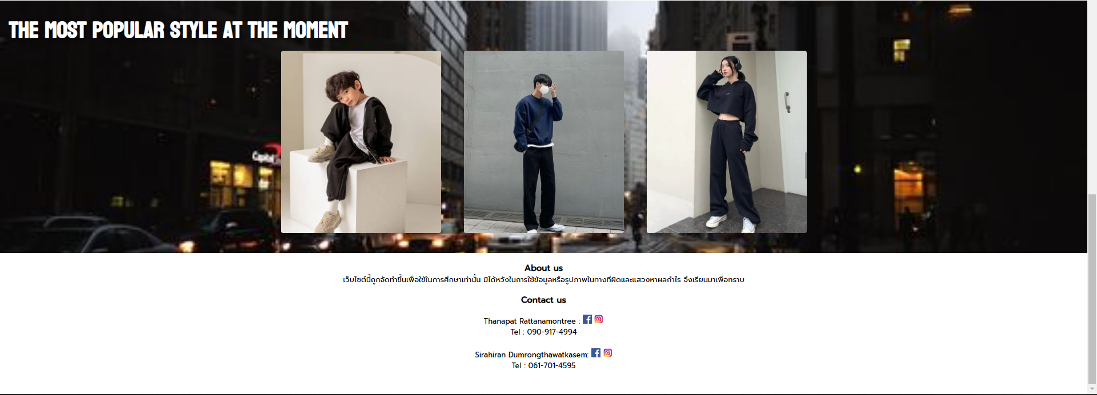
Elements of home’s page
Navigation bar
Page 1
Page 2
Page 3
Page 3
Page 3
Page 4

Slide 8
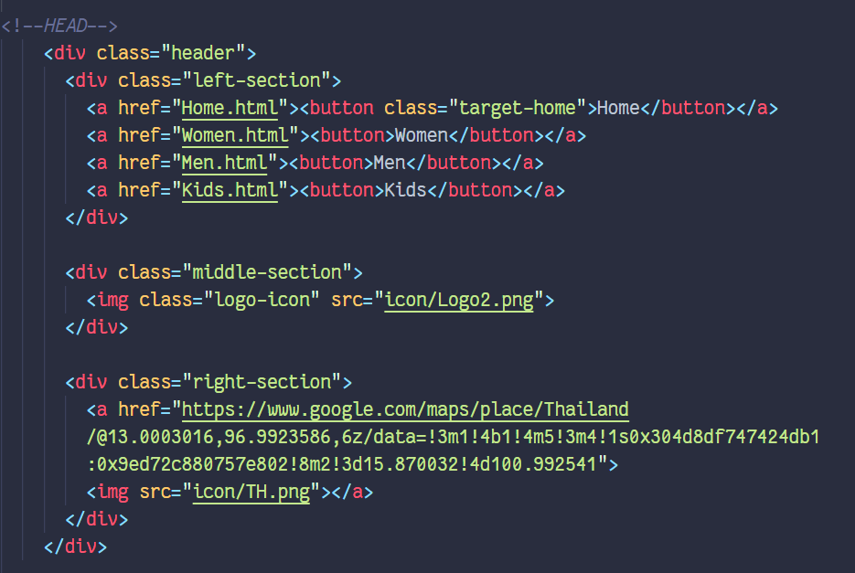
HOME : Navigation bar

Slide 9
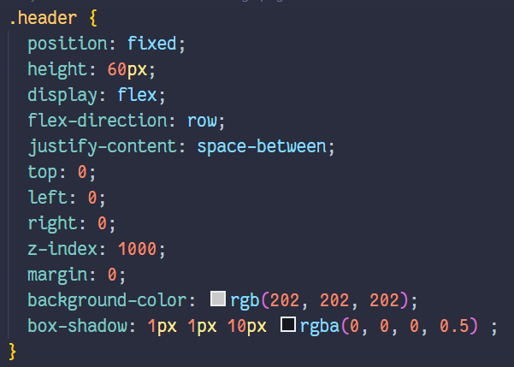
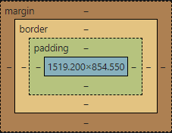

HOME : Navigation bar

Slide 10
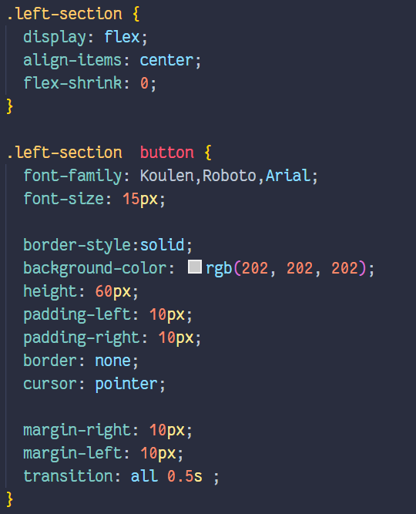
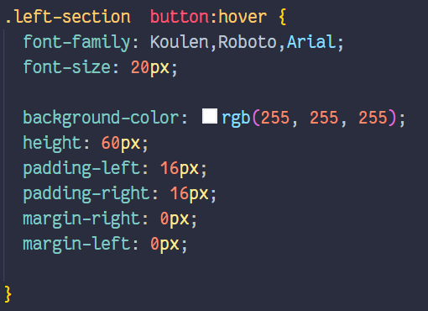
HOME : Navigation bar

Slide 11
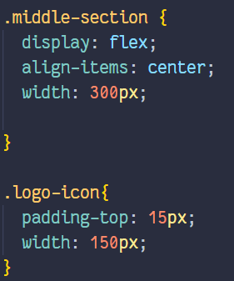
HOME : Navigation bar

Slide 12
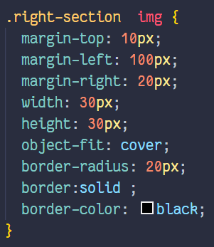
HOME : Navigation bar

Slide 13

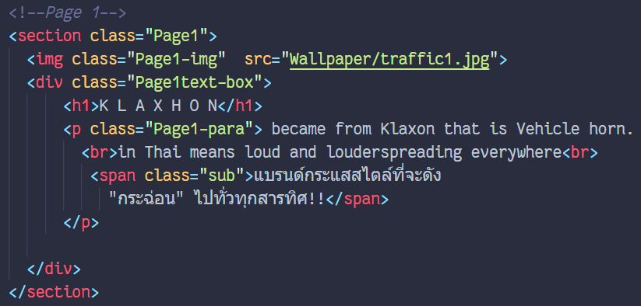
HOME : Page 1

Slide 14
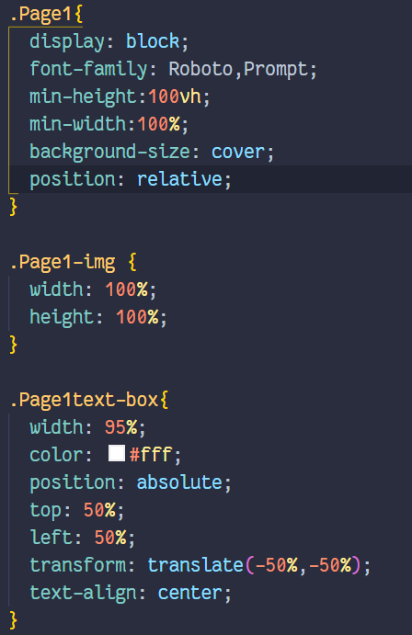
HOME : Page 1

Slide 15
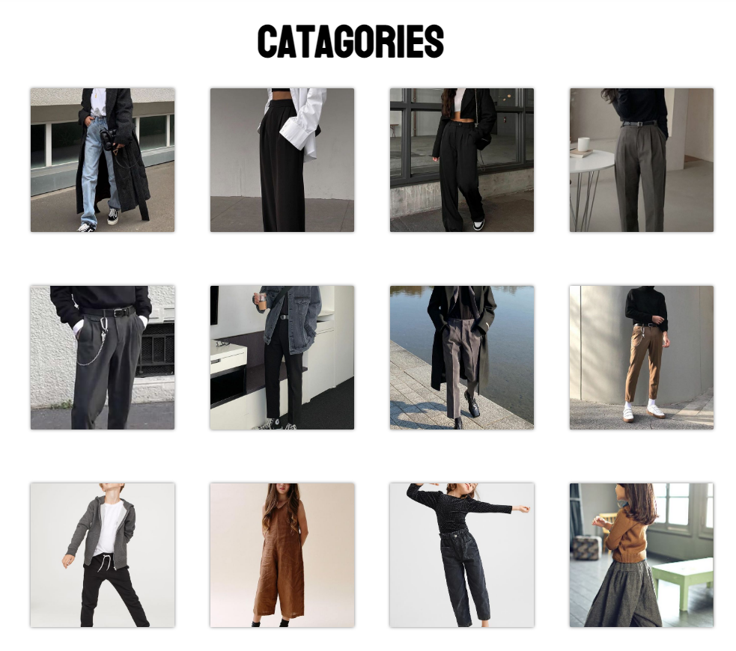
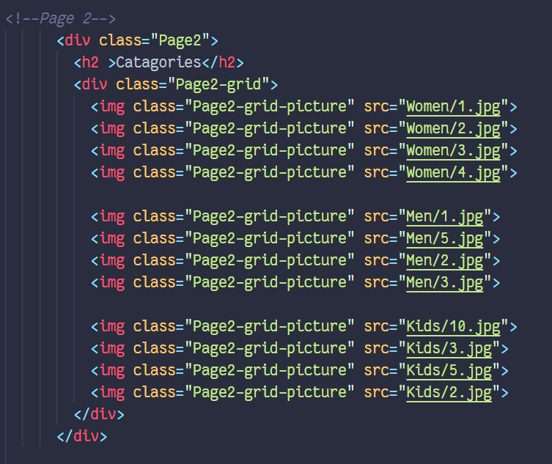
HOME : Page 2

Slide 16
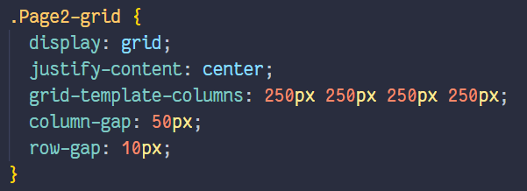
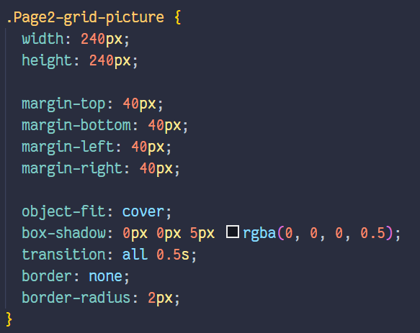
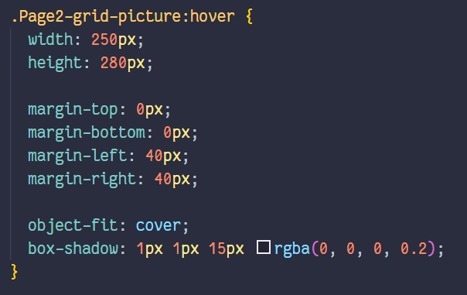
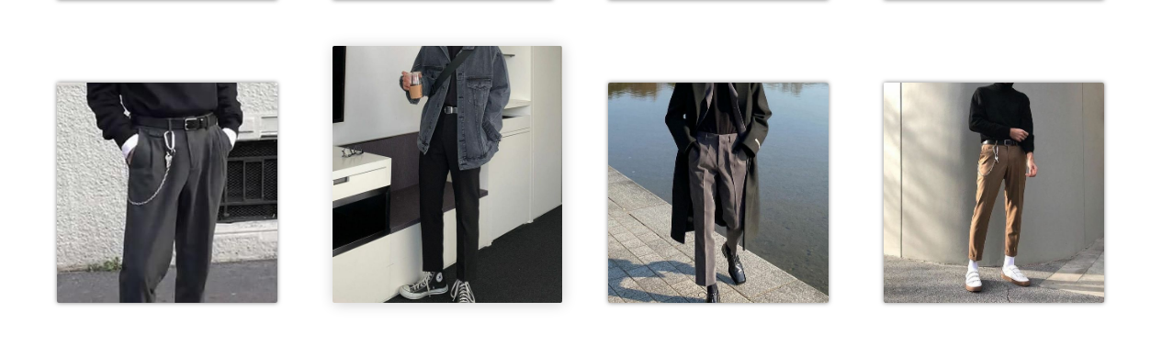
HOME : Page 2

Slide 17
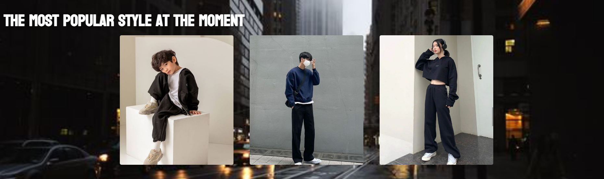
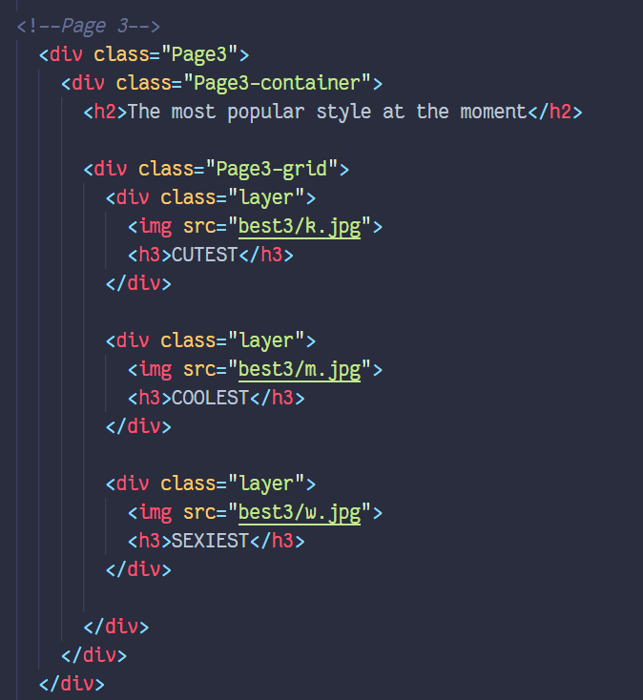
HOME : Page 3

Slide 18
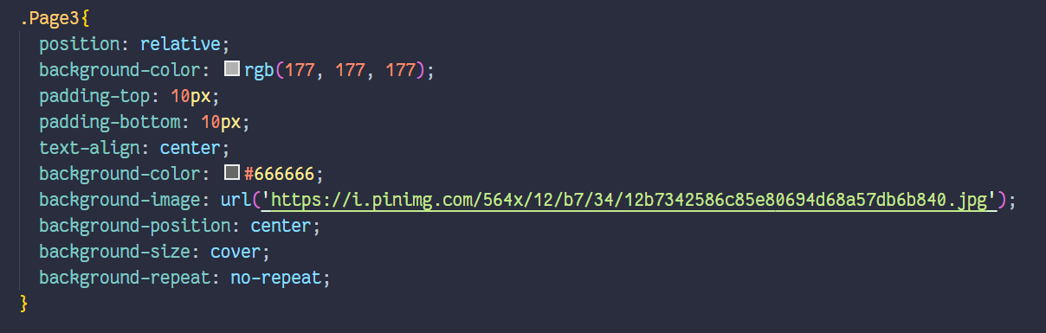
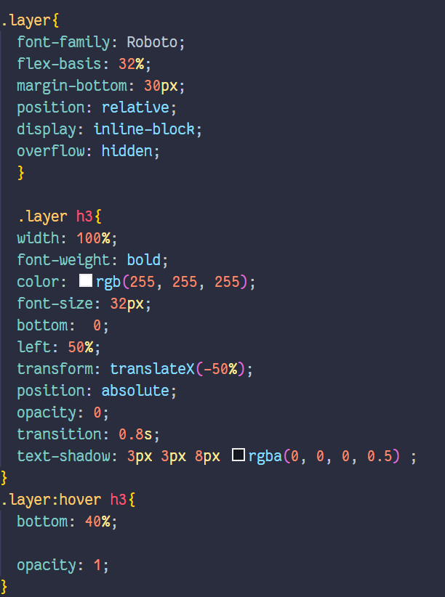
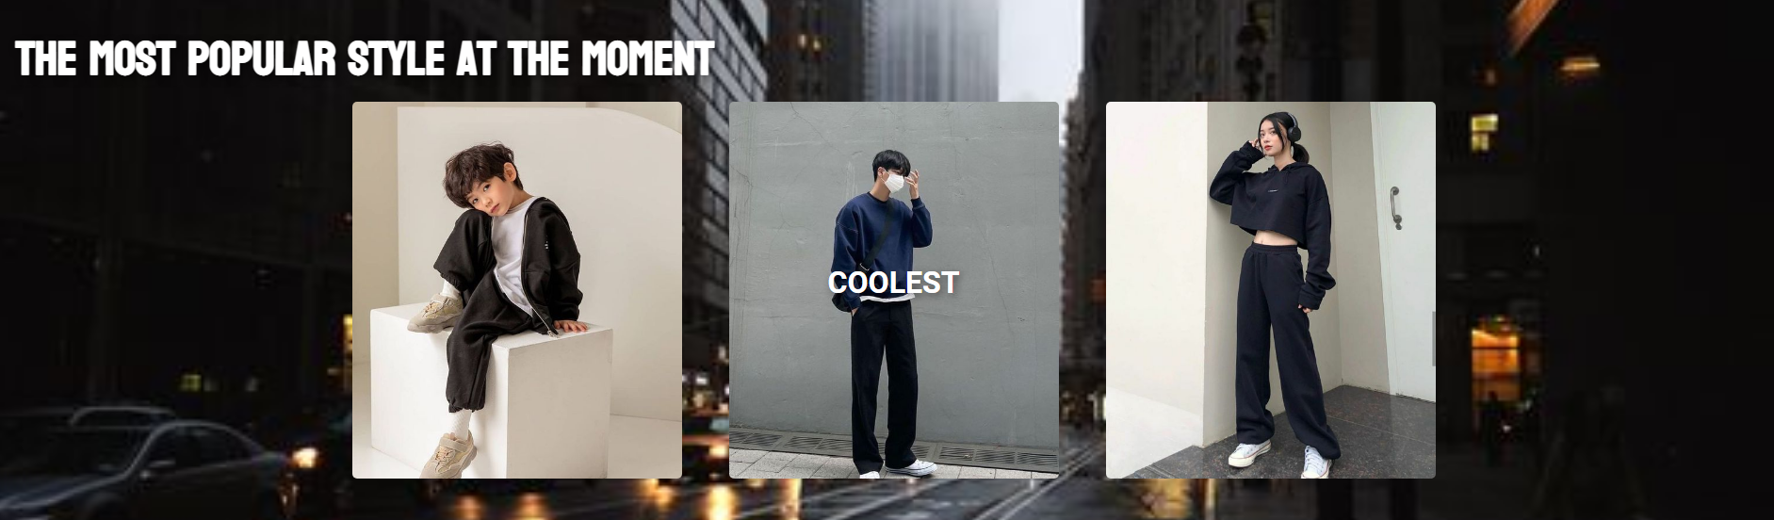
HOME : Page 3

Slide 19
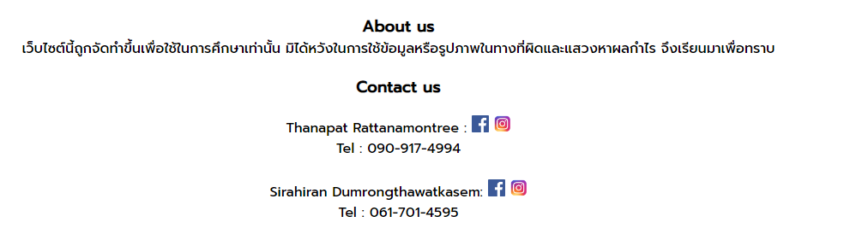
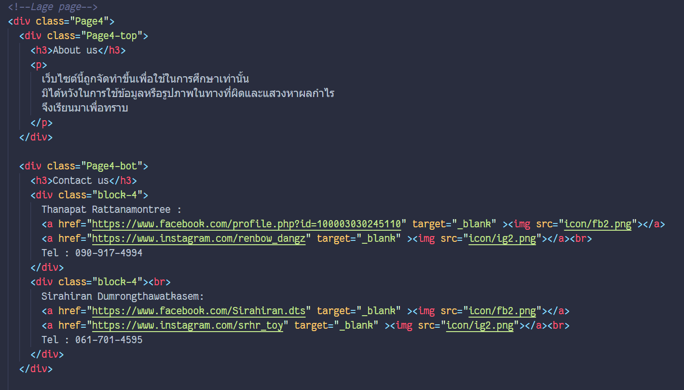
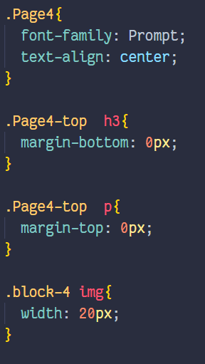
HOME : Page 4

Slide 20
02
WOMEN
You can enter a subtitle here if you need it

Slide 21
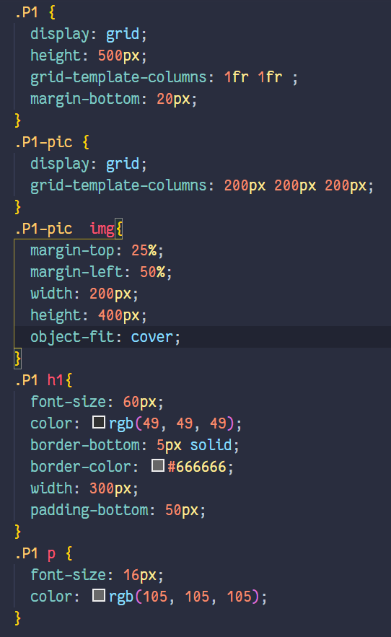
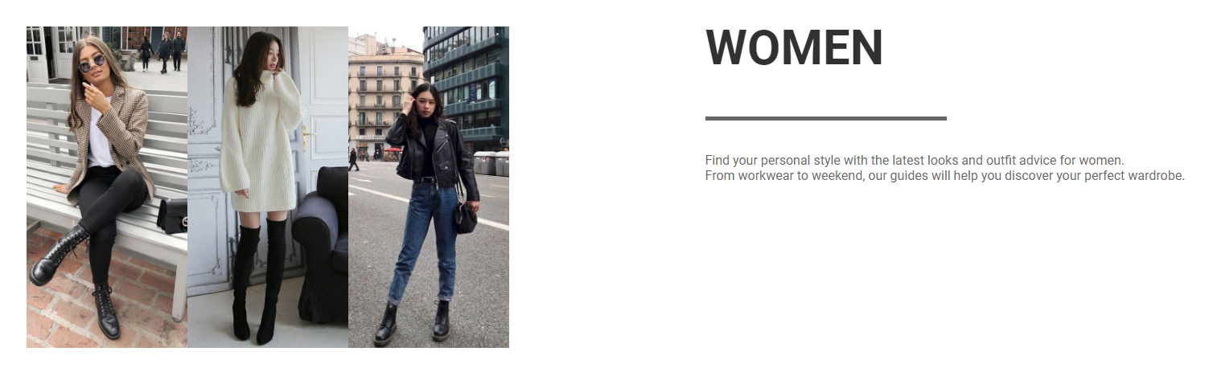
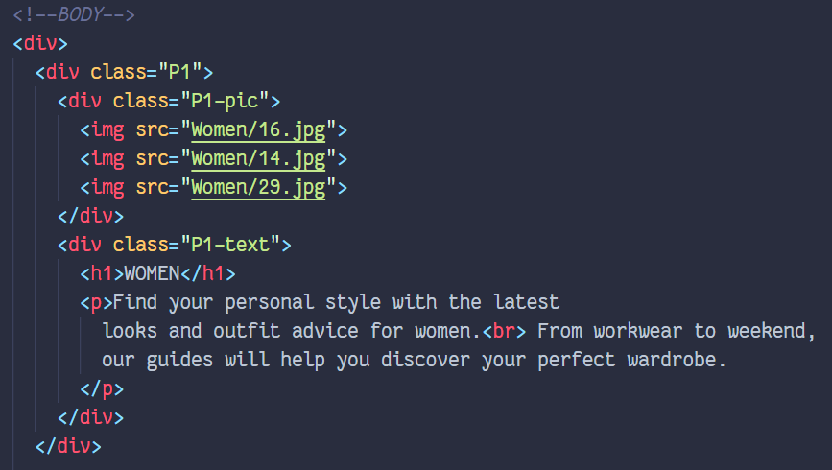
WOMEN : Page 1

Slide 22
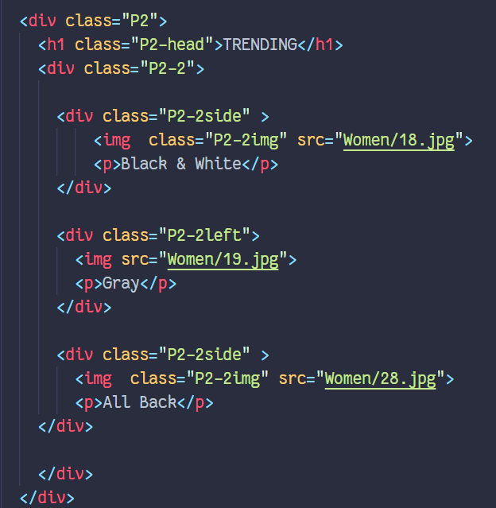
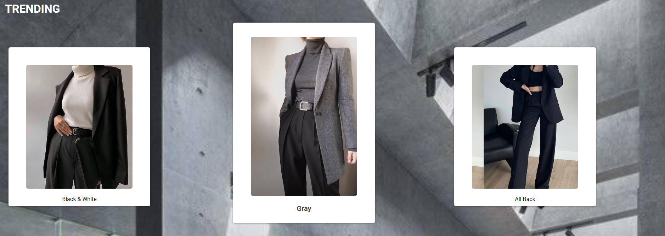
WOMEN : Page 2

Slide 23
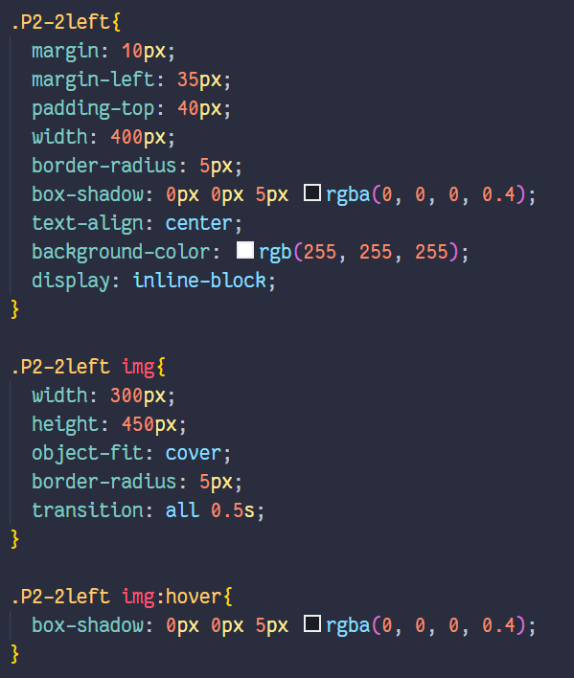
WOMEN : Page 2

Slide 24
03
MEN
You can enter a subtitle here if you need it

Slide 25
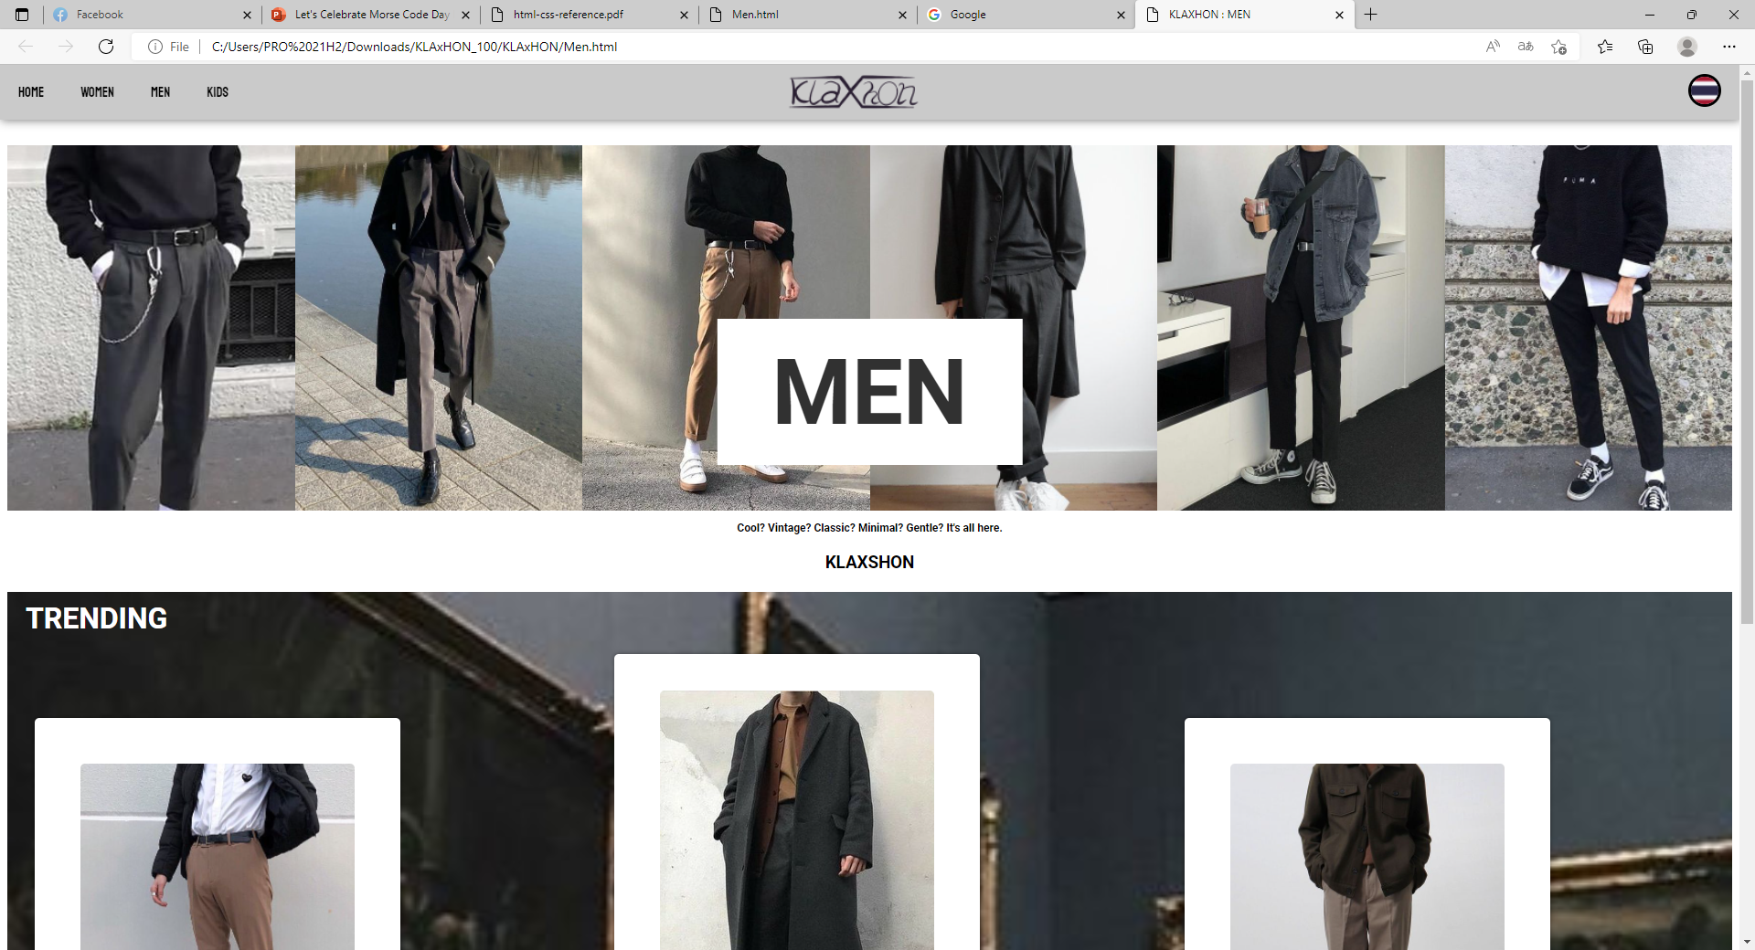
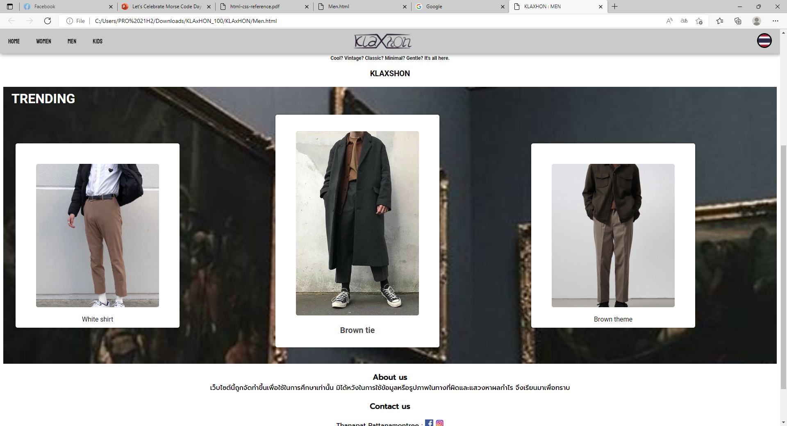
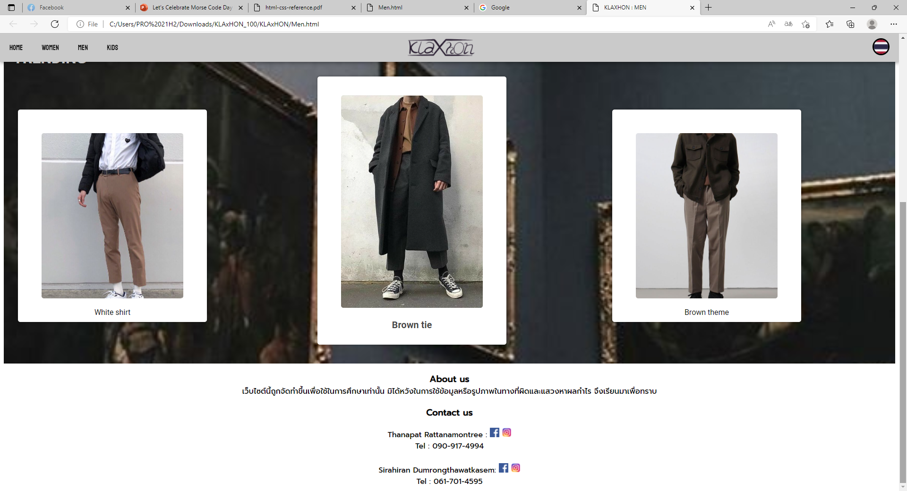
Men page

Slide 26
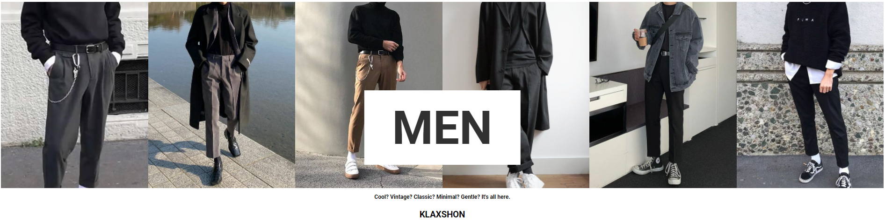
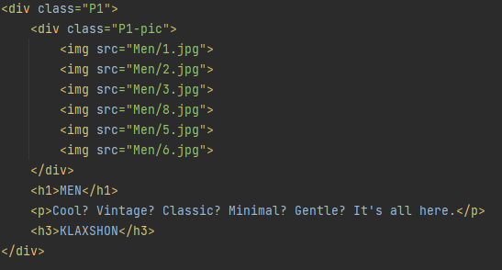
MEN : Page 1

Slide 27
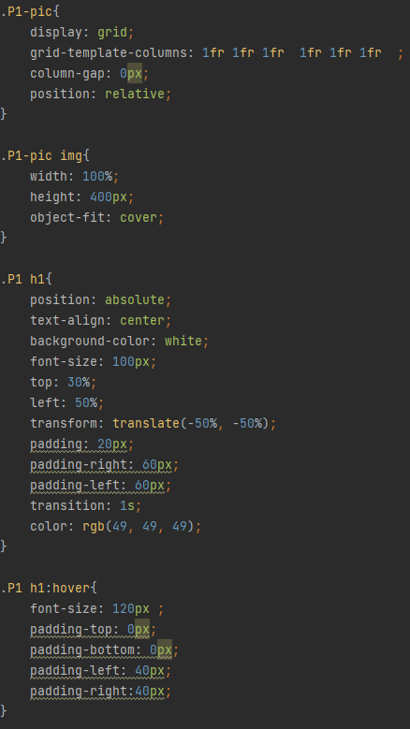
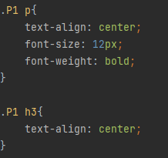
MEN : Page 1

Slide 28
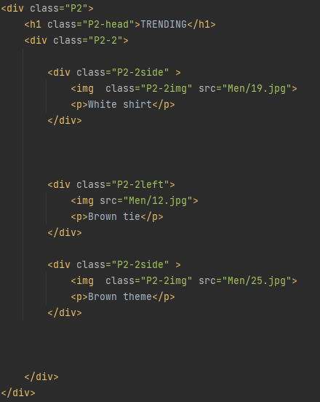
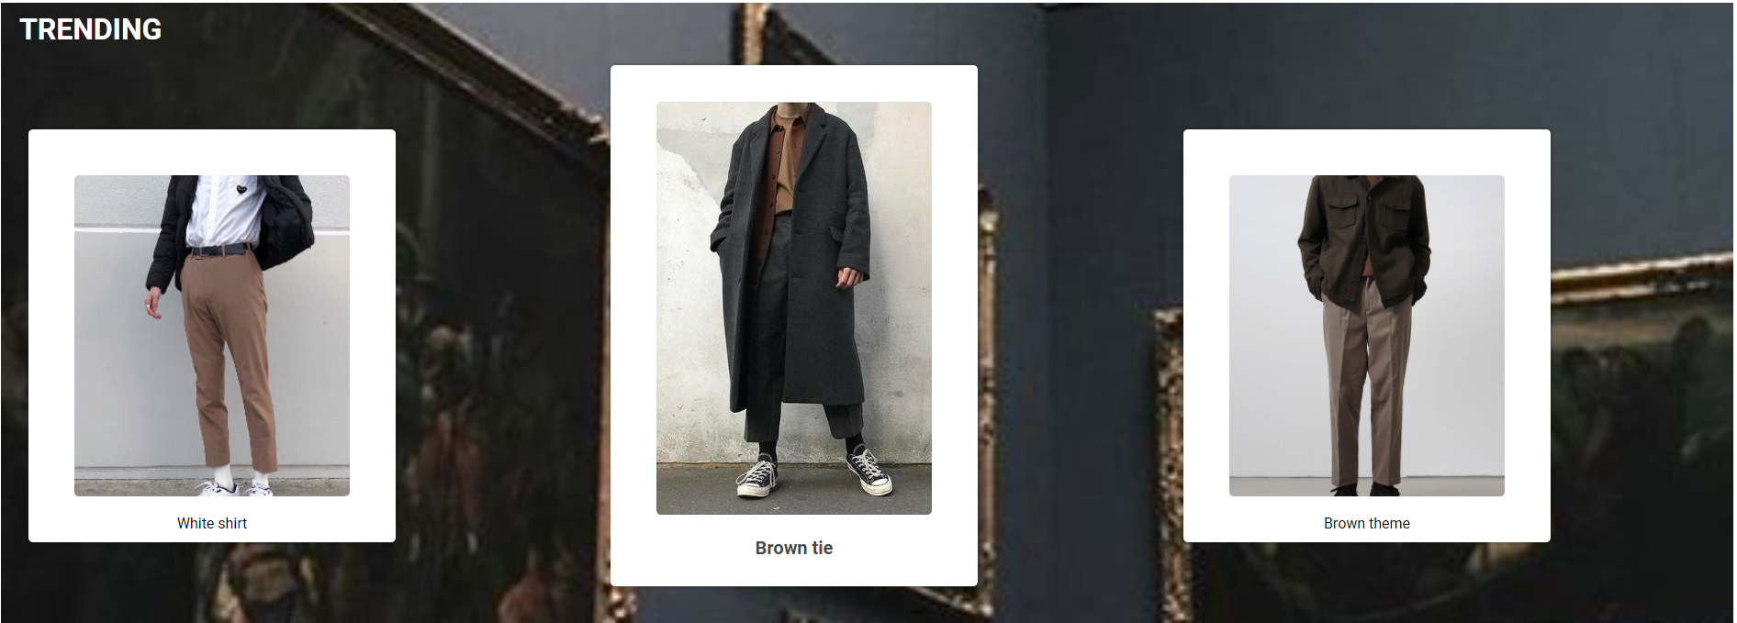
MEN : Page 2

Slide 29
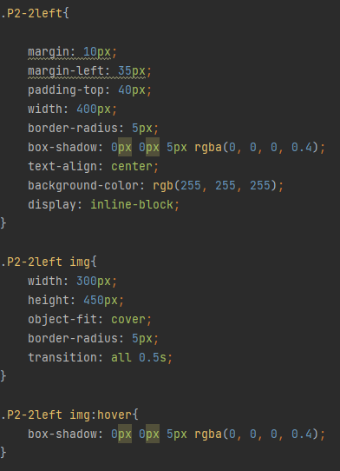
MEN : Page 2

Slide 30
04
KIDS
You can enter a subtitle here if you need it

Slide 31
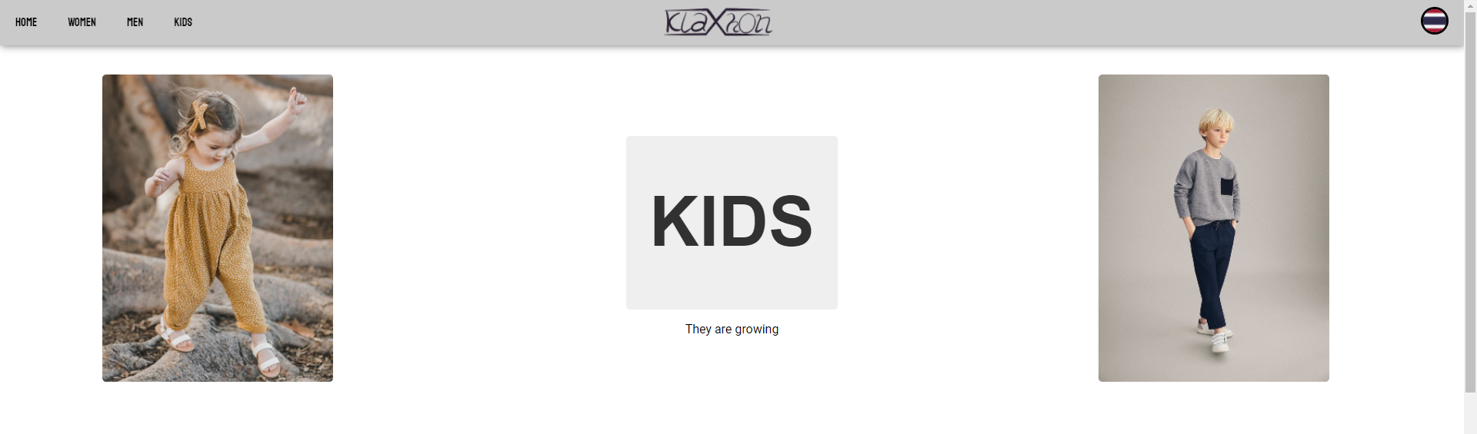
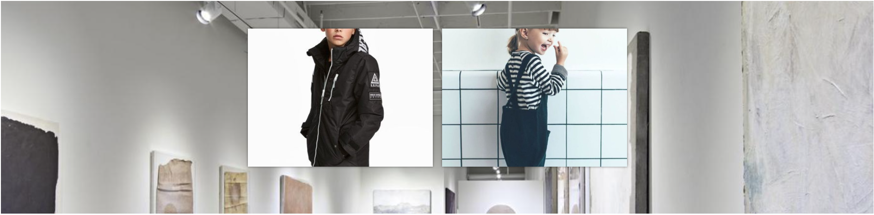
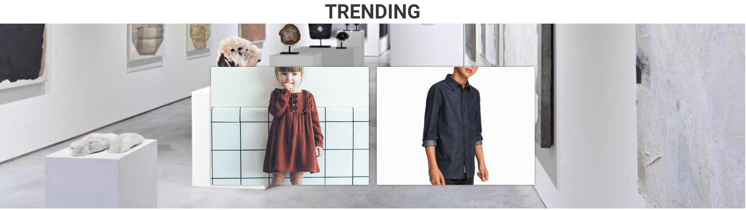
Kid page

Slide 32
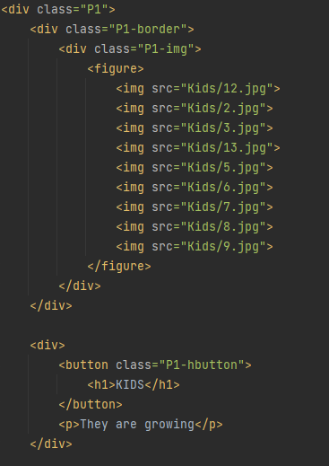
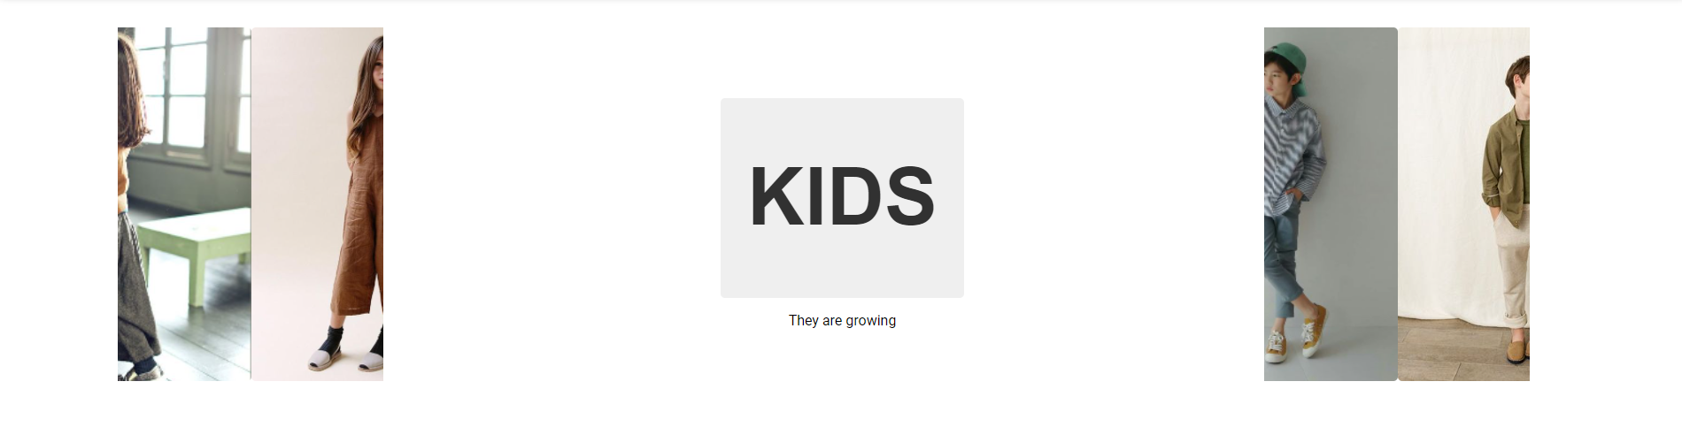
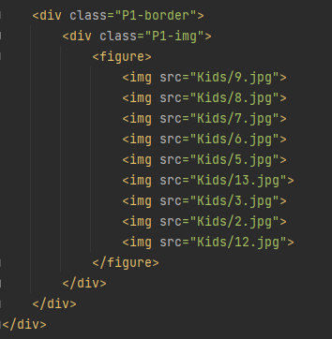
KIDS : Page 1

Slide 33



KIDS : Page 1

Slide 34



KIDS : Page 2

Slide 35

KIDS : Page 2

Slide 36
THANKS!
Do you have any questions?
Thanapat.fight@g.swu.ac.th
+66 90-917-4994
KLAXHON.com
renbow_dangz
Thanapat Rattanamontree

